Slide 1
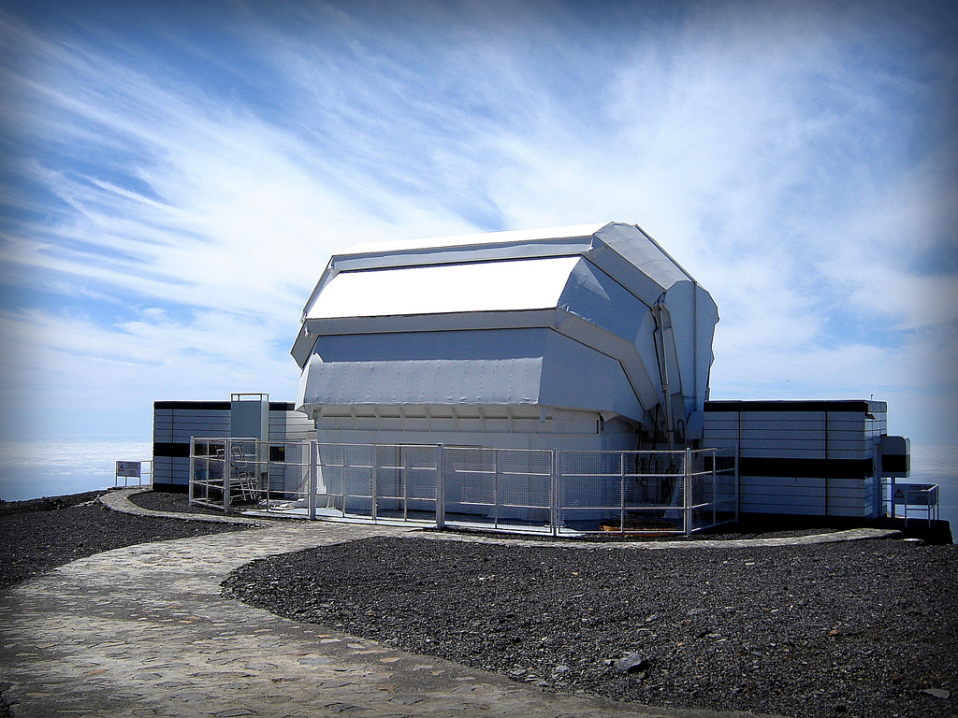
Liverpool Telescope

Slide 2

History
First light in July 2003
Began operations in January 2004
Robotics installed in April 2004
NO observers at night for most nights since December 2004!

Slide 3
Who owns it?
Owned by: Liverpool John Moores University
Operated by: Astrophysics Research Institute (administered by the faculty of science at the Liverpool John Moores University)
Funded by: STFC (PPARC in the beginning)

Slide 4
Specifications
Primary mirror
2m diameter
f/3 focal ratio
0.45m central bore
Secondary mirror
0.62m diameter
Alt/az mount
Altitude range 25-87 degrees
Ritchey–Chrétien telescope
Fully robotic
f/10 focus at Cassegrain

Slide 5
Instruments
Decommissioned
IO:THOR (Fast Readout Optical Camera)
SupIRCam (Infrared array camera)
RINGO (Optical Polarimeter)
RINGO2 (Optical Polarimeter)
Meaburn (Spectrometer)
RATCam (Optical CCD camera)

Slide 6
Instruments
In operation
IO:O (Optical Wide Field Camera)
RISE (Fast-readout Wide Field Camera)
RINGO3 (Tri-band Optical Polarimeter)
FRODOspec (Fibre-fed Robotic Dual-beam Optical Spectrograph)
SkyCam (Fixed 180° all-sky plus piggyback 20° & 1° cameras)

Slide 7
What makes it special?
Fully autonomous
List of observations
Can be interrupted (and then resumed)

Slide 8
Scientific Goals
Rapid robotic reaction to unpredictable phenomena and their systematic followup
Small scale surveys and serendipitous source followup
Monitoring of variable objects on all timescales from seconds to years
Simultaneous coordinated observations with other ground and space based facilities

Slide 9
Scientific Goals
Study variable astronomical phenomena – (seconds – years)
Variable stars, accretion disks around blackholes, neutron stars, white dwarf stars; quasars and active galactic nucleii; gravitational lenses, and moving targets like asteroids and comets.
Rapid reaction mode to study novae, supernovae, and the optical counterparts of gamma-ray burst sources.

Slide 10
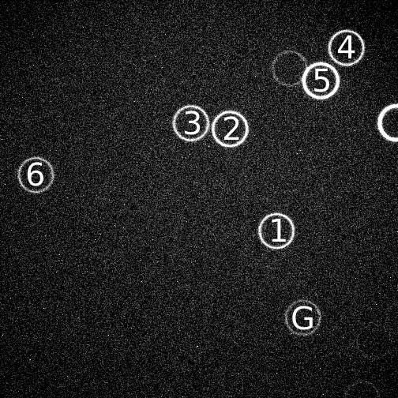
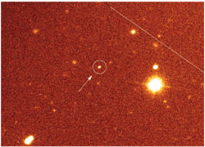
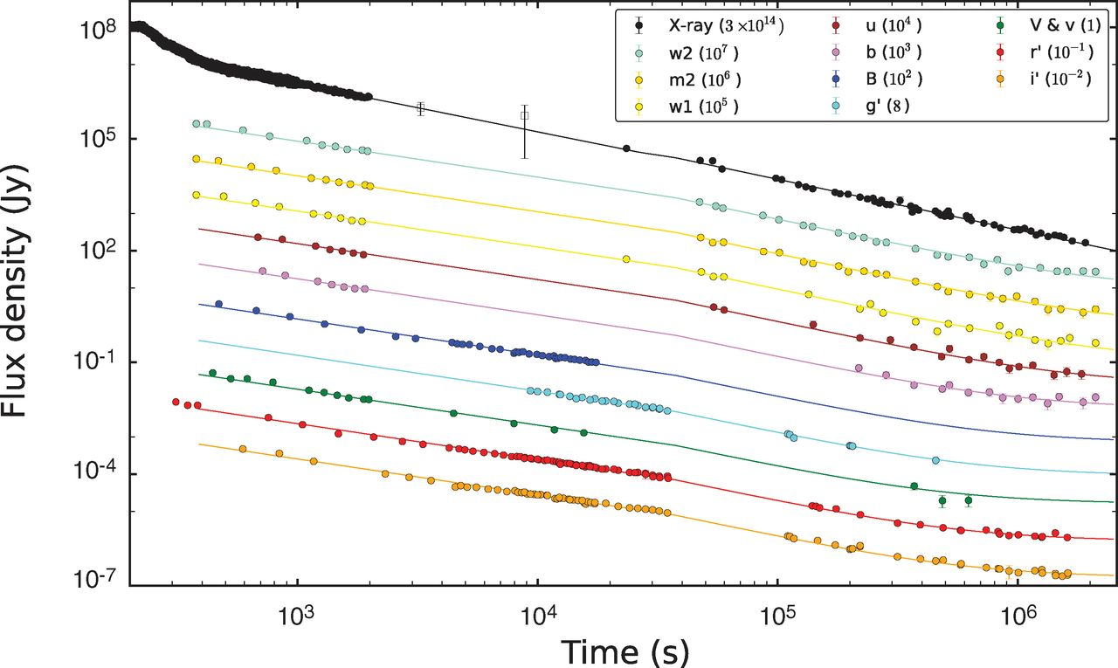
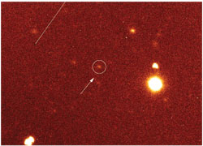
Highlights
Gamma ray bursts (GRB 130427A)

Slide 11
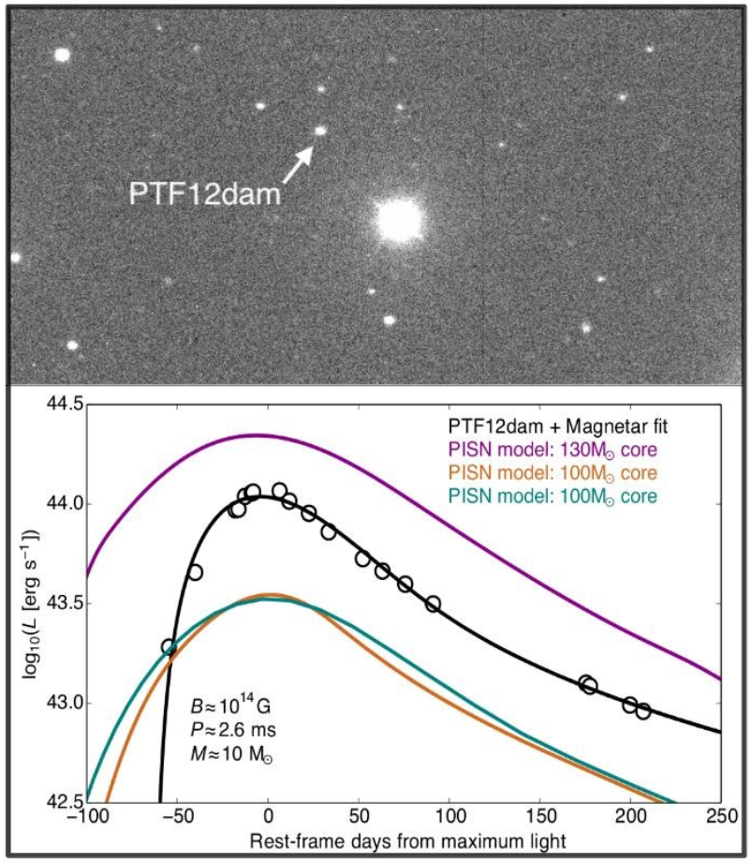
Highlights
Super-luminous Supernova PTF12dam
10-100 times normal
Magnetar core
Team at
University Belfast

Slide 12
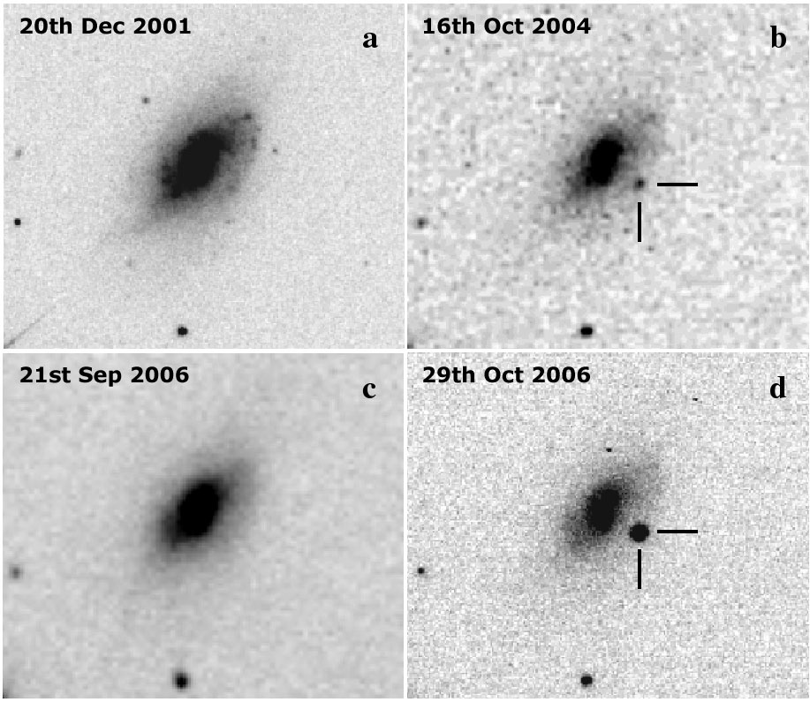
Highlights
Double Supernova in UGC4904 (SN2006jc)
First time observed
Observations used
to show that it must
have been a
Wolf-Rayet star

Slide 13
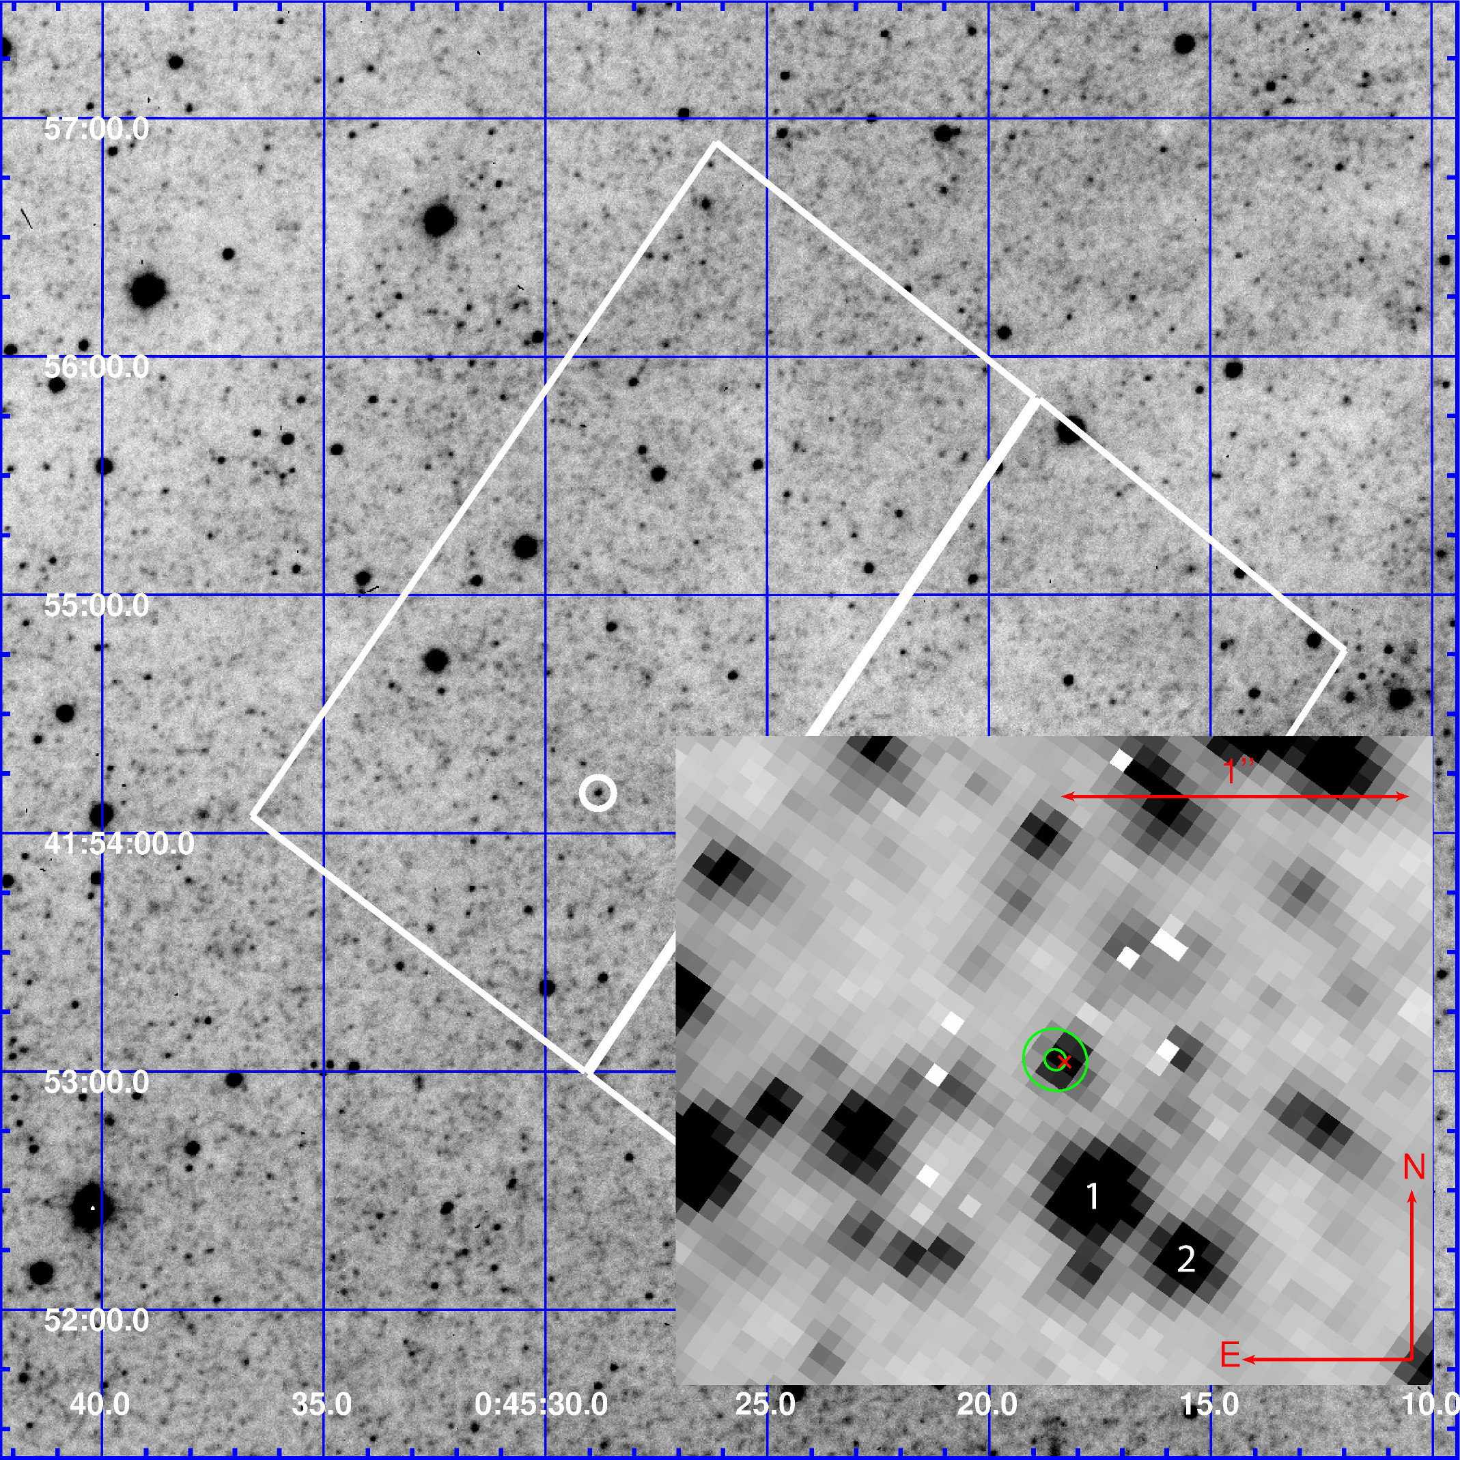
Highlights
Recurring nova in M31

Slide 14
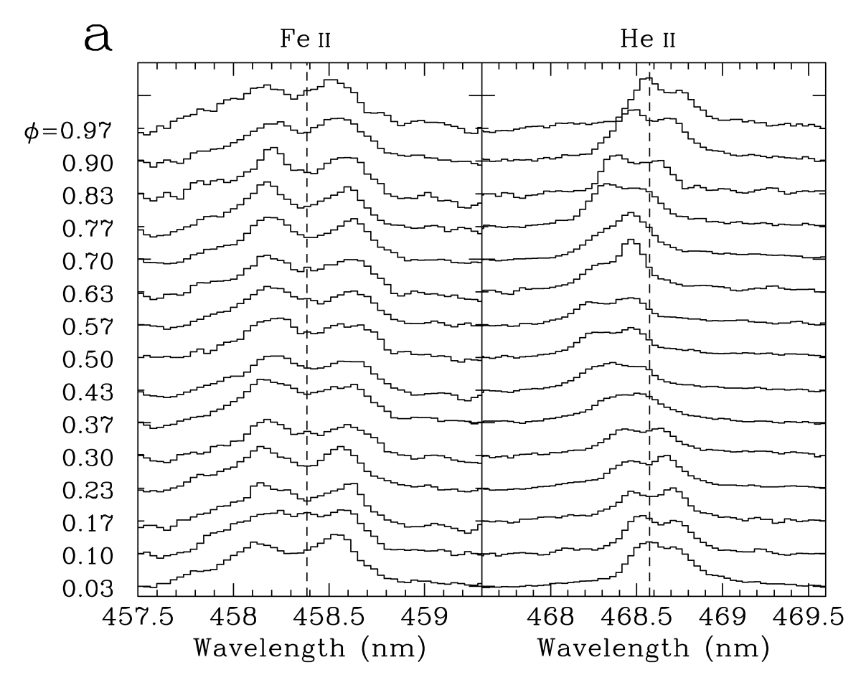
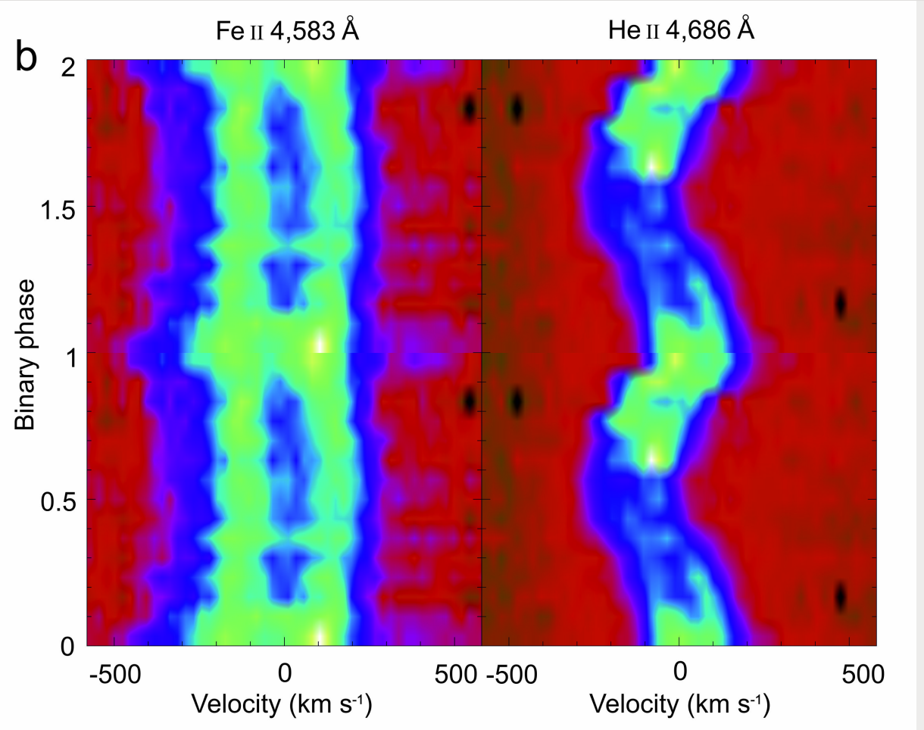
Highlights
Black hole orbiting spinning star

Slide 15
Future
A second one is planned!
Primary mirror with 4m diameter

Slide 16
Sources
Pictures of the telescope from Wikipedia
The rest from the Liverpool Telescope website
http://telescope.livjm.ac.uk/

